Slide 1
M.A IVth Semester
Indian literature in English
Poetry and Drama
Tughlaq by Girish Karnad
-By Dr. Manisha Agarwal

Slide 2
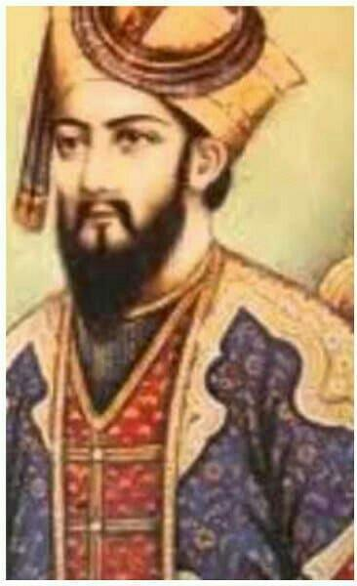
Tughlaq is a 1964 Indian play written by Girish Karnad, an Indian actor, film director, writer, playright and scholar.
The 13 scene play is set during the reign of Muhammad bin Tughlaq who ruled in India in 14th century.
Tughlaq is the play which brought name and fame to Karnad.
The play exposes the character of one of the most fascinating Kings, Tughlaq who occupied the throne of Delhi from 1325-1351.
He is fascinating because though he was one of the most learned monarchs of Delhi, and had great ideas and a grand vision, his reign was also an abject failure.

Slide 3
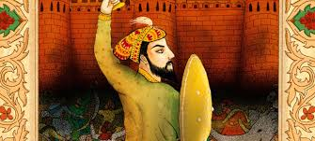
The central theme of the play is the complexity in the character of Sultan Tughlaq, who has both the elements good as well as evil. He is a visionary man as well as man of action.
From the very first scene we come to know about the complex personality of Tughlaq. He is considered as a learned and an intelligent man.
He has the abilities to learn and curiosity to know and he is master in playing chess, he has the knowledge of ‘Quran more than any Sheikh.

Slide 4
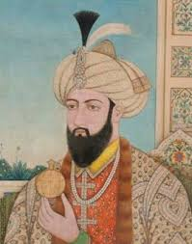
Tughlaq is one of the learned and accomplished men of his age.
He has unmatched scientific and literary acumen in his age.
He is a master in the subject of history.
His favourite pastime- to sit next to patients to learn proper diagnosis when among with physicians.
He was liberal in nature and made hospital ,alms-houses on a large scale for the poor and widowed.
He wants his life as a garden of roses, where even thrones also give delight; his imagination expresses his sense about literature.

Slide 5
He starts his rule with great ideals- of a unified India, of Hindus and Muslims being equal in the eyes of the state (he abolished the onerous tax Jaziya on the Hindus)
The play recaptures the significant events starting shortly after Tughaq’s ascension to the throne: his proclamations of idealism, his calling upon his people to be a part of the building of a new empire, of prosperity, peace and amity.
But he ascended the throne by dubious means, killing his father and brother during prayertime. This lead to a lack of credibility among his followers from the time he ascended the throne- no one believed what he professed.
The play outlines his clever plots to eliminate his opponents and his surviving an assassination attempt by his own courtiers.

Slide 6
The play mainly focuses on the three major decisions of Tughlaq that brought about downfall.
The decision to shift the capital from Delhi to Daulatabad as he surmised that Delhi was too near the borders and easily open to invaders to attack, whereas Daulatabad was situated at the heart of the country. This caused trouble to his subjects, army and administration.
People found it intolerable and felt home-sick.

Slide 7
The decision to introduce copper currency in the place of silver currency as he notices that silver coins are becoming scarce.
Historians believed that he was influenced from the paper currency in use in China during his rule.

Slide 8
The decision to impose tax on the farmers of Doab Valley. It was the place between Ganga and Yamuna rivers and the land was very fertile there. The farmers were rich and were in a condition to pay tax.
But there was famine at that time and farmers were unable to pay the tax so they all left the place

Slide 9
Tughlaq is defined as a historical play because the chief protagonist is a character taken from history and the play documents a series of past events that took place during the reign of Mohammad-bin-Tughlaq.

Slide 10
Tughlaq can also be considered a political play as it represents the reign of a king and his various moves to unify the Hindus and Muslims, and establish a just kingdom in Delhi.

Slide 11
The play also represents and explores the psychological dilemmas faced by the king.
The play also emphasises on the outcome of the choices that Tughlaq makes.
All his choices and decisions are made with full knowledge and awareness. But the same choices and decisions bring about his downfall. However, he is a person who stands firmly by his decisions despite its horrible outcomes.
His citizens and councillors can hardly understand his fore-sightedness and oppose him bitterly.
In one of his interviews, Karnad says that twenty-two year period of Tughlaq’s dynasty offers a striking parallel to the first two decades of Indian Independence under Nehru’s idealist but troubled leadership. Nehru was remarkably like Tughlaq in his propensity for failure despite an extraordinary intellect.

Slide 12
Tughlaq is a sensitive portrayal of a visionary ruler who is progressive in his outlook and wants to establish a political system based on equality irrespective of the existing class, caste and religious difference. Tughlaq tried to unify the Hindus and the Muslims: but the result was merely disillusionment and chaos.

