Slide 1
Cubism
By :- Dr. Vandana Verma
Associate Professor
Drg. & Ptg. department
J.K.P.(P.G) College
Muzaffarnagar

Slide 2
Definition
Cubism is a style of art which aims to show all of the possible viewpoints of a person or an object all at once. It is called Cubism because the objects represented in the artworks look like they are made out of cubes and other geometrical shapes. Cubism was first started by Pablo Picasso and Georges Braque.

Slide 3
Time Period
Cubism is an early-20th-century art movement which brought European painting forward toward 20th century Modern art.
According to Cooper there was "Early Cubism", (from 1906 to 1908) when the movement was initially developed in the studios of Picasso and Braque; the second phase being called "High Cubism", (from 1909 to 1914) during which time Juan Gris emerged as an important exponent (after 1911); and finally Cooper referred to "Late Cubism" (from 1914 to 1921) as the last phase of Cubism as a radical avant-garde movement. Douglas Cooper's restrictive use of these terms to distinguish the work of Braque, Picasso, Gris (from 1911) and Léger (to a lesser extent) implied an intentional value judgement.

Slide 4
Style
Analytical Cubism
Mechanistic Cubism
Synthetic Cubism
Colonial Cubism

Slide 5
Artist
Georges Braque
Pablo Picasoo

Slide 6
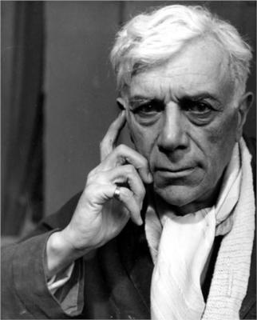
Georges Braque
Born: May 13, 1882
Died: August 31, 1963
Active Years: 1900 - 1963
Nationality: French
Art Movement: Cubism
Painting School: École de Paris, Les Fauves
Field: painting, sculpture
Influenced by: Nicolas Poussin
Influenced on: David Alfaro Siqueiros, Vilhelm Lundstrom, Mikhail Larionov, Carlos Nadal

Slide 7
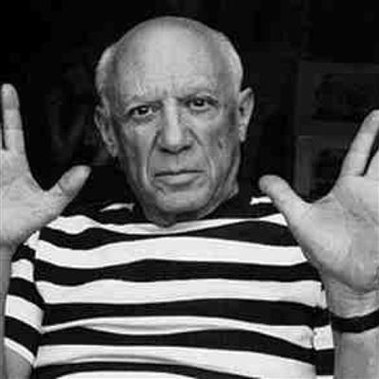
Pablo Picasoo
Pablo Diego José Francisco de Paula Juan Nepomuceno María de los Remedios Cipriano de la Santísima Trinidad Ruiz y Picasso
Born: October 25, 1881; Málaga, Spain
Died: April 8, 1973; Mougins, France
Active Years: 1895 - 1973
Nationality: Spanish
Art Movement: Cubism, Post-Impressionism, Neoclassicism, Surrealism
Painting School: École de Paris
Field: painting, sculpture, drawing, lithography, graphics
Influenced by: Marc Chagall, Henri Rousseau, El Greco, Francisco Goya, Paul Gauguin, Paul Cezanne, Henri Matisse, Auguste Rodin, Nicolas Poussin, Pierre-Auguste Renoir
Influenced on: Marc Chagall, Amedeo Modigliani, Willem de Kooning, Jasper Johns, Arshile Gorky, Lee Krasner, Jackson Pollock, Robert Delaunay, Piet Mondrian, Karel Appel, Balcomb Greene, Francis Bacon, David Alfaro Siqueiros, Salvador Dali, Tamara de Lempicka, Vilhelm Lundstrom, Cubism, Surrealism, Pop Art, Conceptual Art
Art institution: Real Academia de Bellas Artes de San Fernando, Madrid, Spain

